Slide 1
Exploratory Data Analysis DataSet : Automatic checkout, warehouse, or stock inventory System
Nama : Mufita Rahmadina
Group : Auto_6

Slide 2
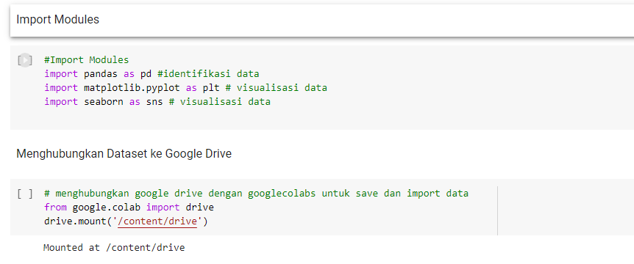
Exploratory Data Analysis DataSet : Automatic checkout, warehouse, or stock inventory System

Slide 3
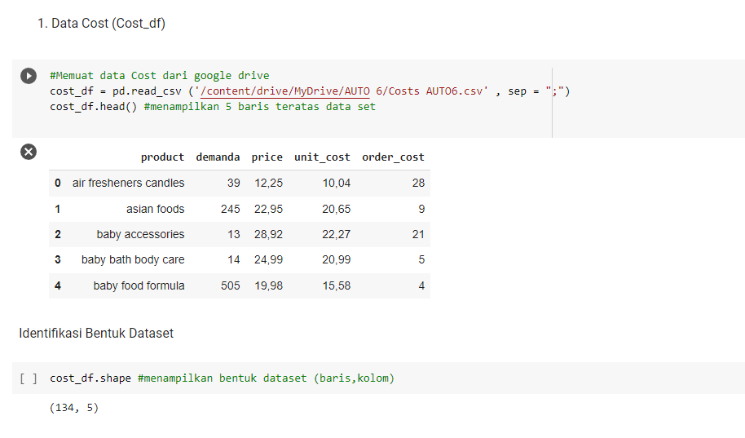
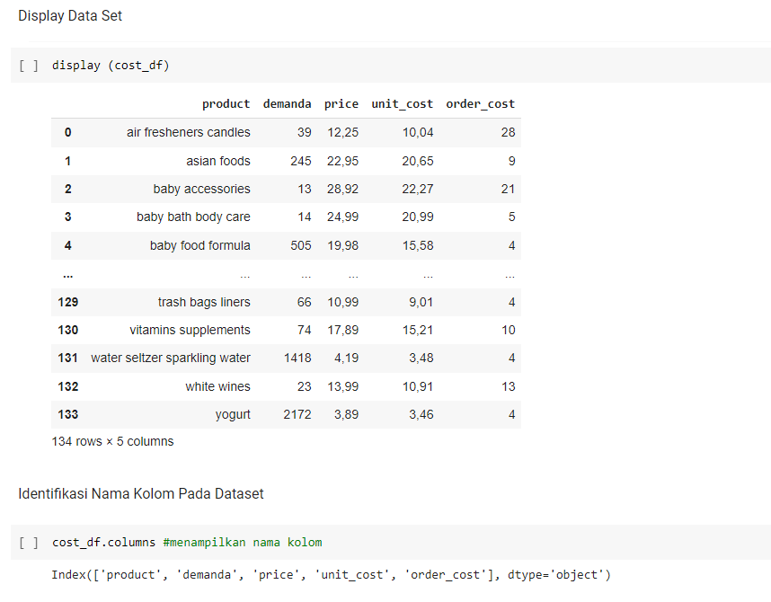

Slide 4
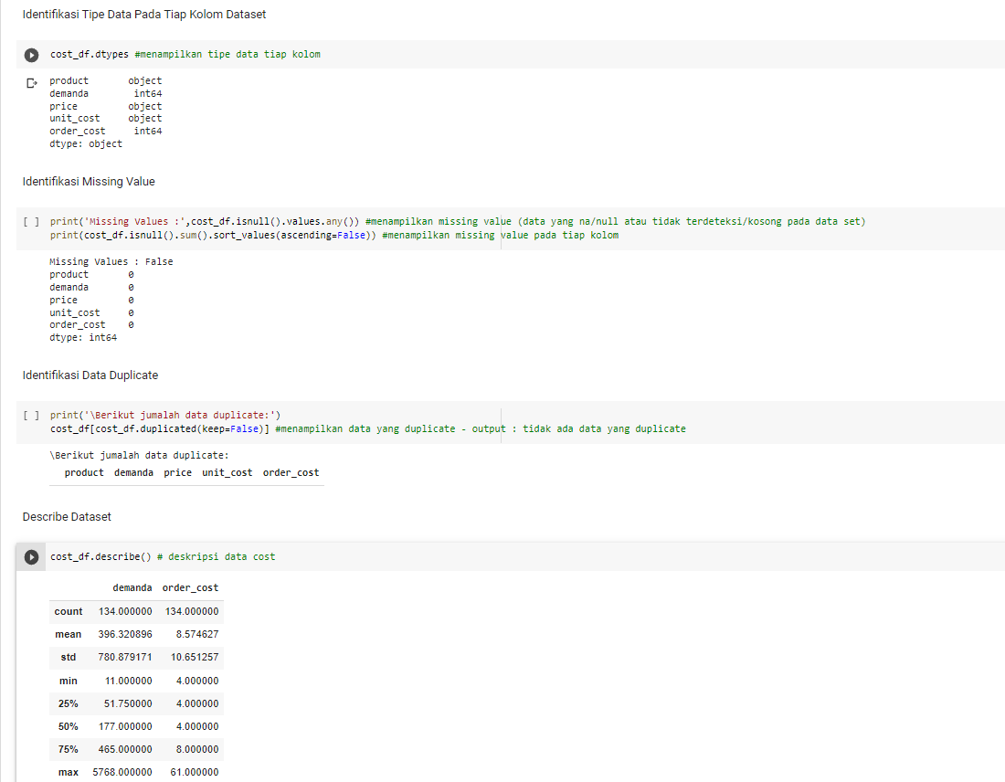

Slide 5
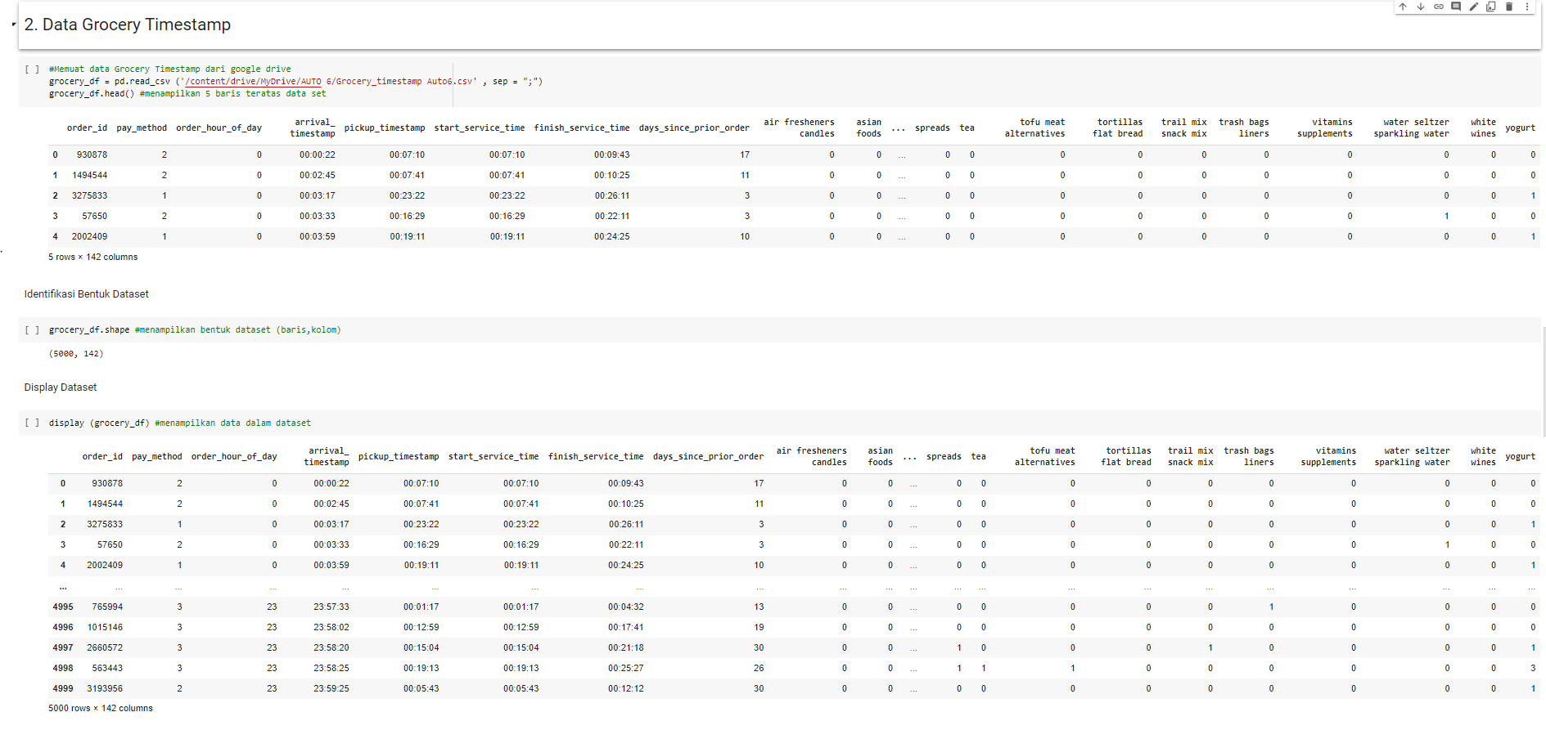

Slide 6
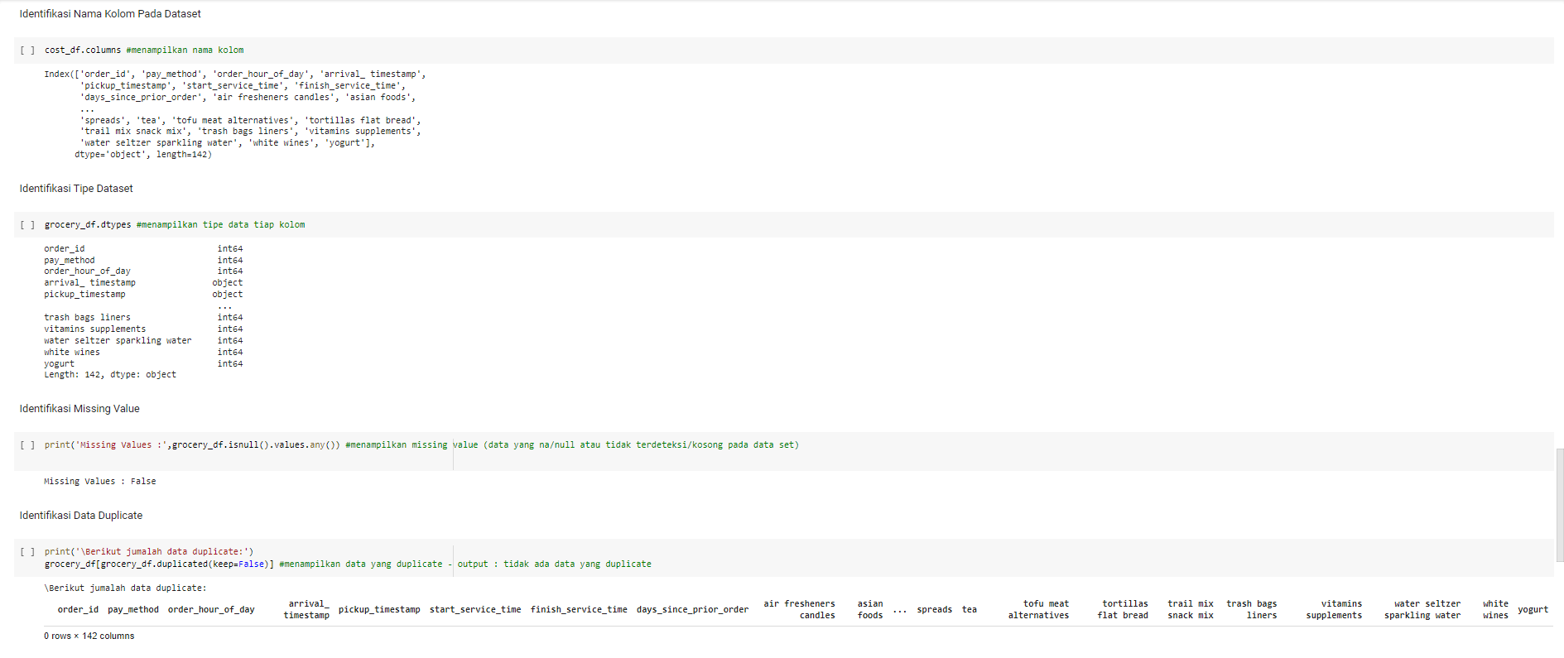

Slide 7
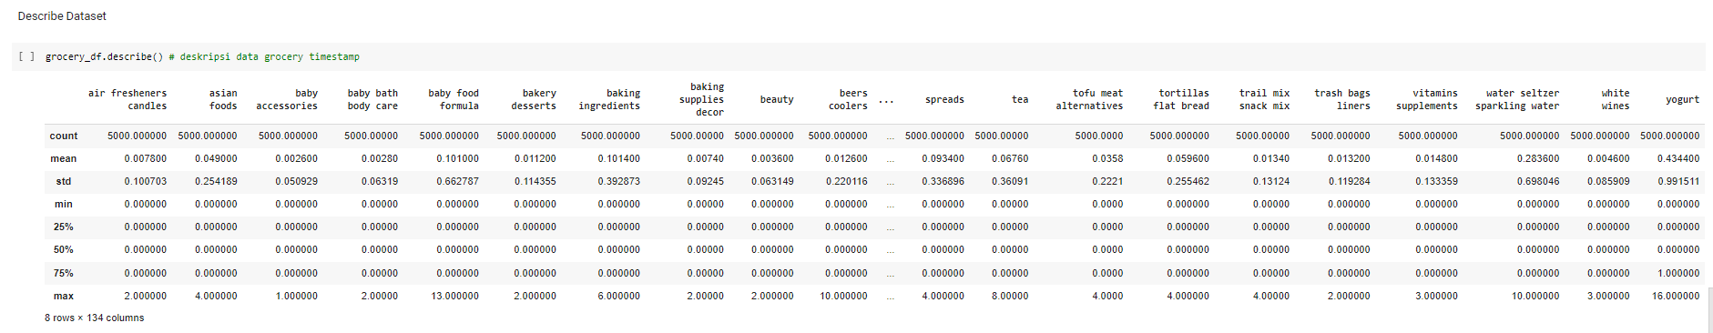

Slide 8
Terima Kasih

